Slide 1
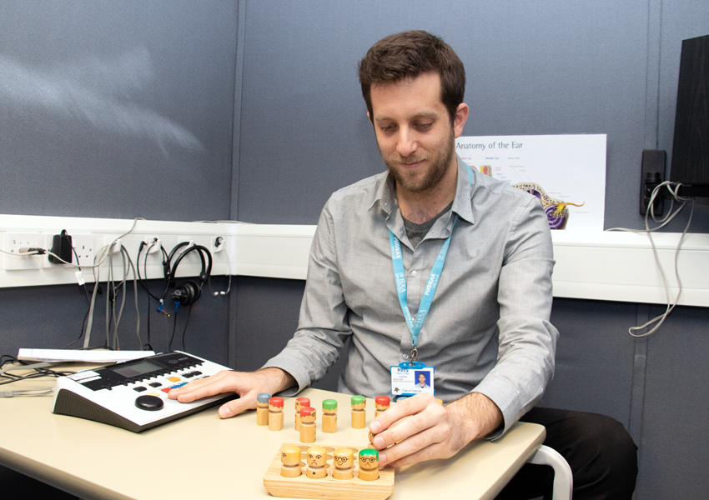
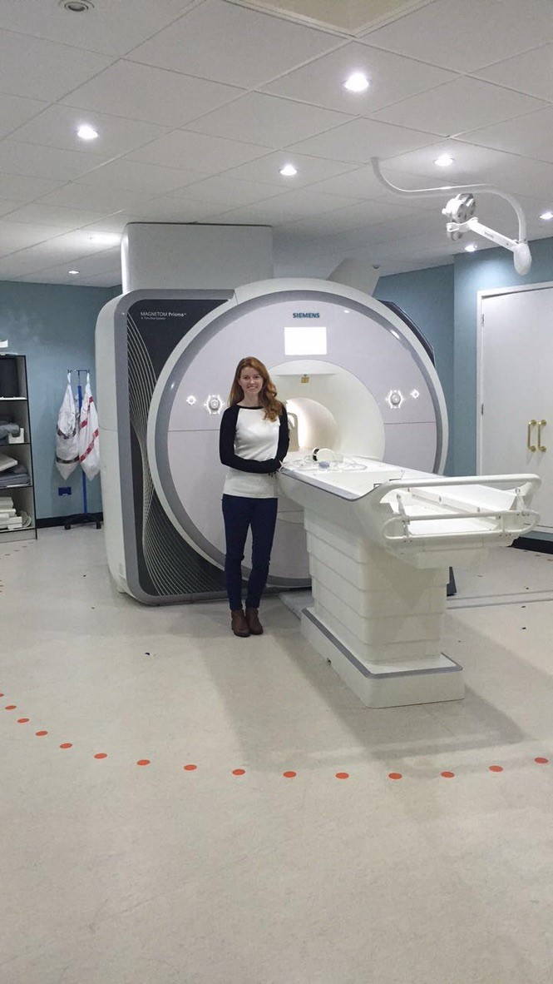
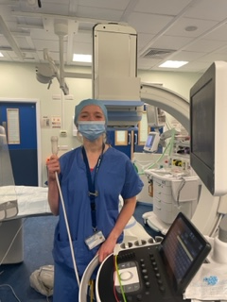
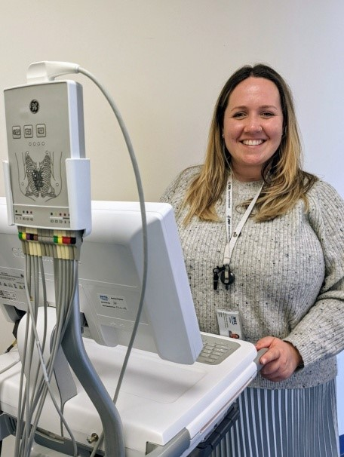
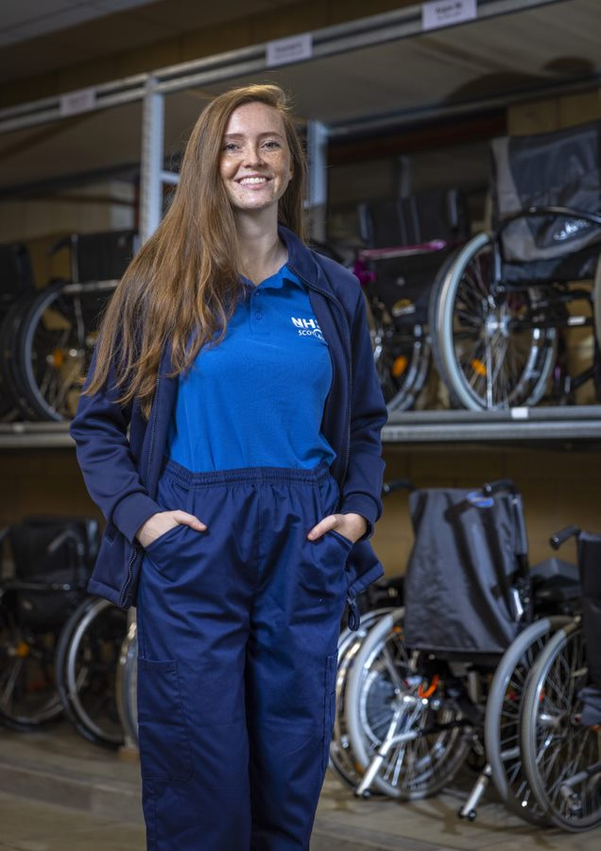
Overview of Healthcare Science

Slide 2
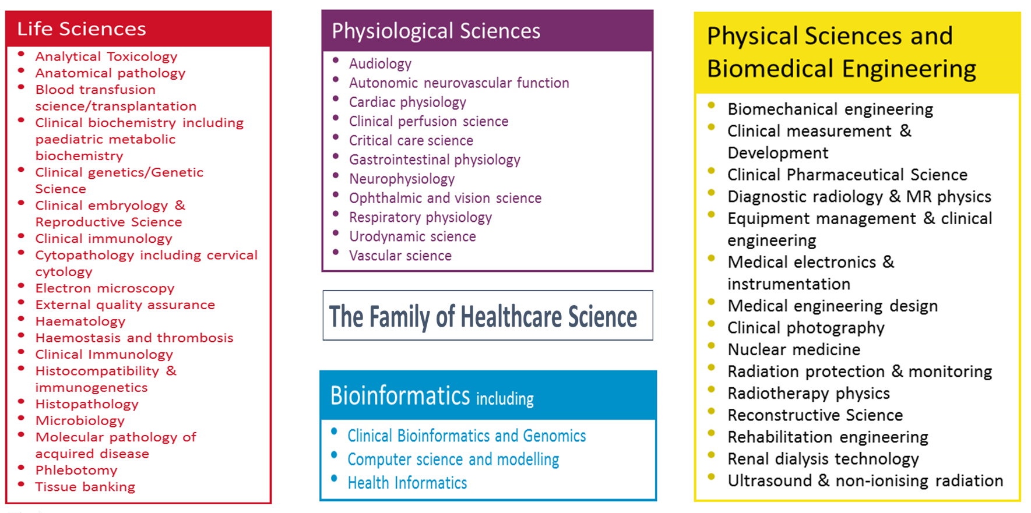
What is Healthcare Science
Notes:
Healthcare science describes the branch of the NHS staff that use technology and science to help patients. We are the 4th largest group of NHS staff with approximately 6000 healthcare scientists in post across NHS Scotland.
Healthcare Science (HCS) spans over 50 disciplines categorised within four streams: Life; Physiological; Bioinformatics and Physical Sciences and biomedical engineering as outlined in the slide.

Slide 3
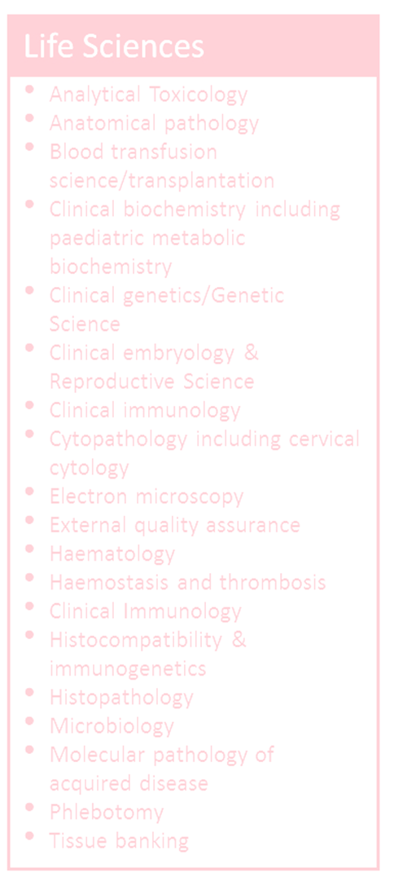
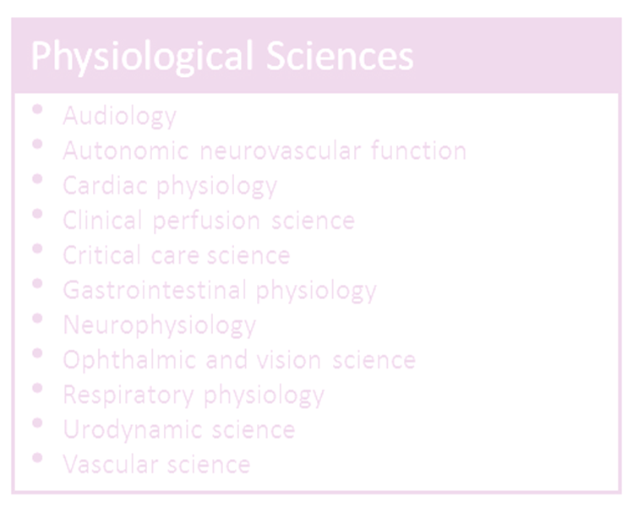
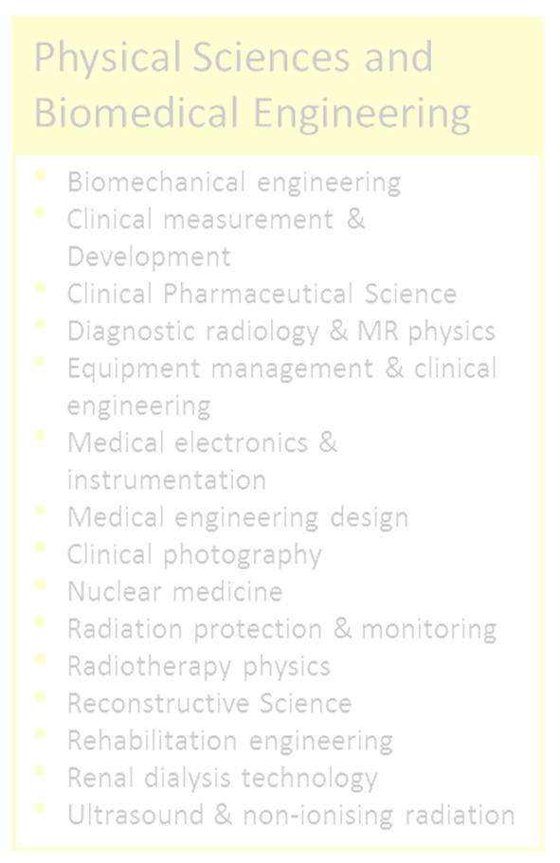
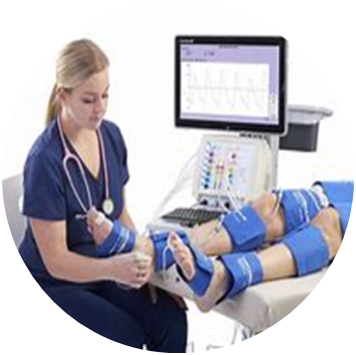
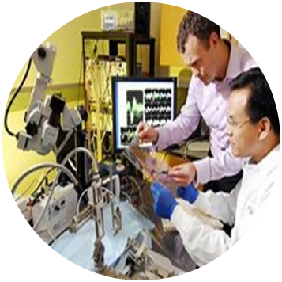
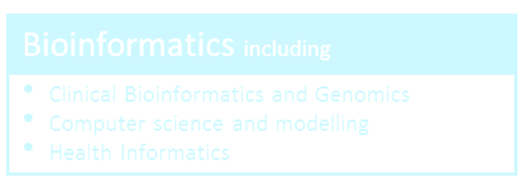
Healthcare scientists
Notes:
We span every part of the patient pathway from carrying out tests and investigations that assist in the diagnosis of the patient or help in monitoring disease/ condition through to providing interventions and therapeutics and we are also involved in rehabilitation
Who are healthcare scientists?
Healthcare scientists use science, data, product design, and engineering to:
· prevent, diagnose, monitor, and treat medical conditions
· design and develop custom medical devices
· commission and maintain medical equipment
· make, improve, and adapt assistive technology
The healthcare science workforce is involved in 80% of diagnostic decisions throughout the patient journey. They’re at the heart of improving healthcare and advancing scientific development through technology and innovation.
We are also involved in clinical research – advancing how we test patients to make it quicker and better.
We work in a variety of areas –
The main hospitals
The General Practitioners
Within the community
Life Science – Biomedical Scientists / Support workers/ Clinical Scientists working in laboratories for diagnostic testing in a variety of disciplines such as Haematology, Blood Transfusion, genetics, microbiology,
Physiology – Physiologists that run tests on patients such as tests to see how well your heart or your lungs are working
Medical Physics – photographers or engineers who help calibrate and maintain all of the equipment you see within a hospital setting
Bioinformatics – people who work with lots of data

Slide 4
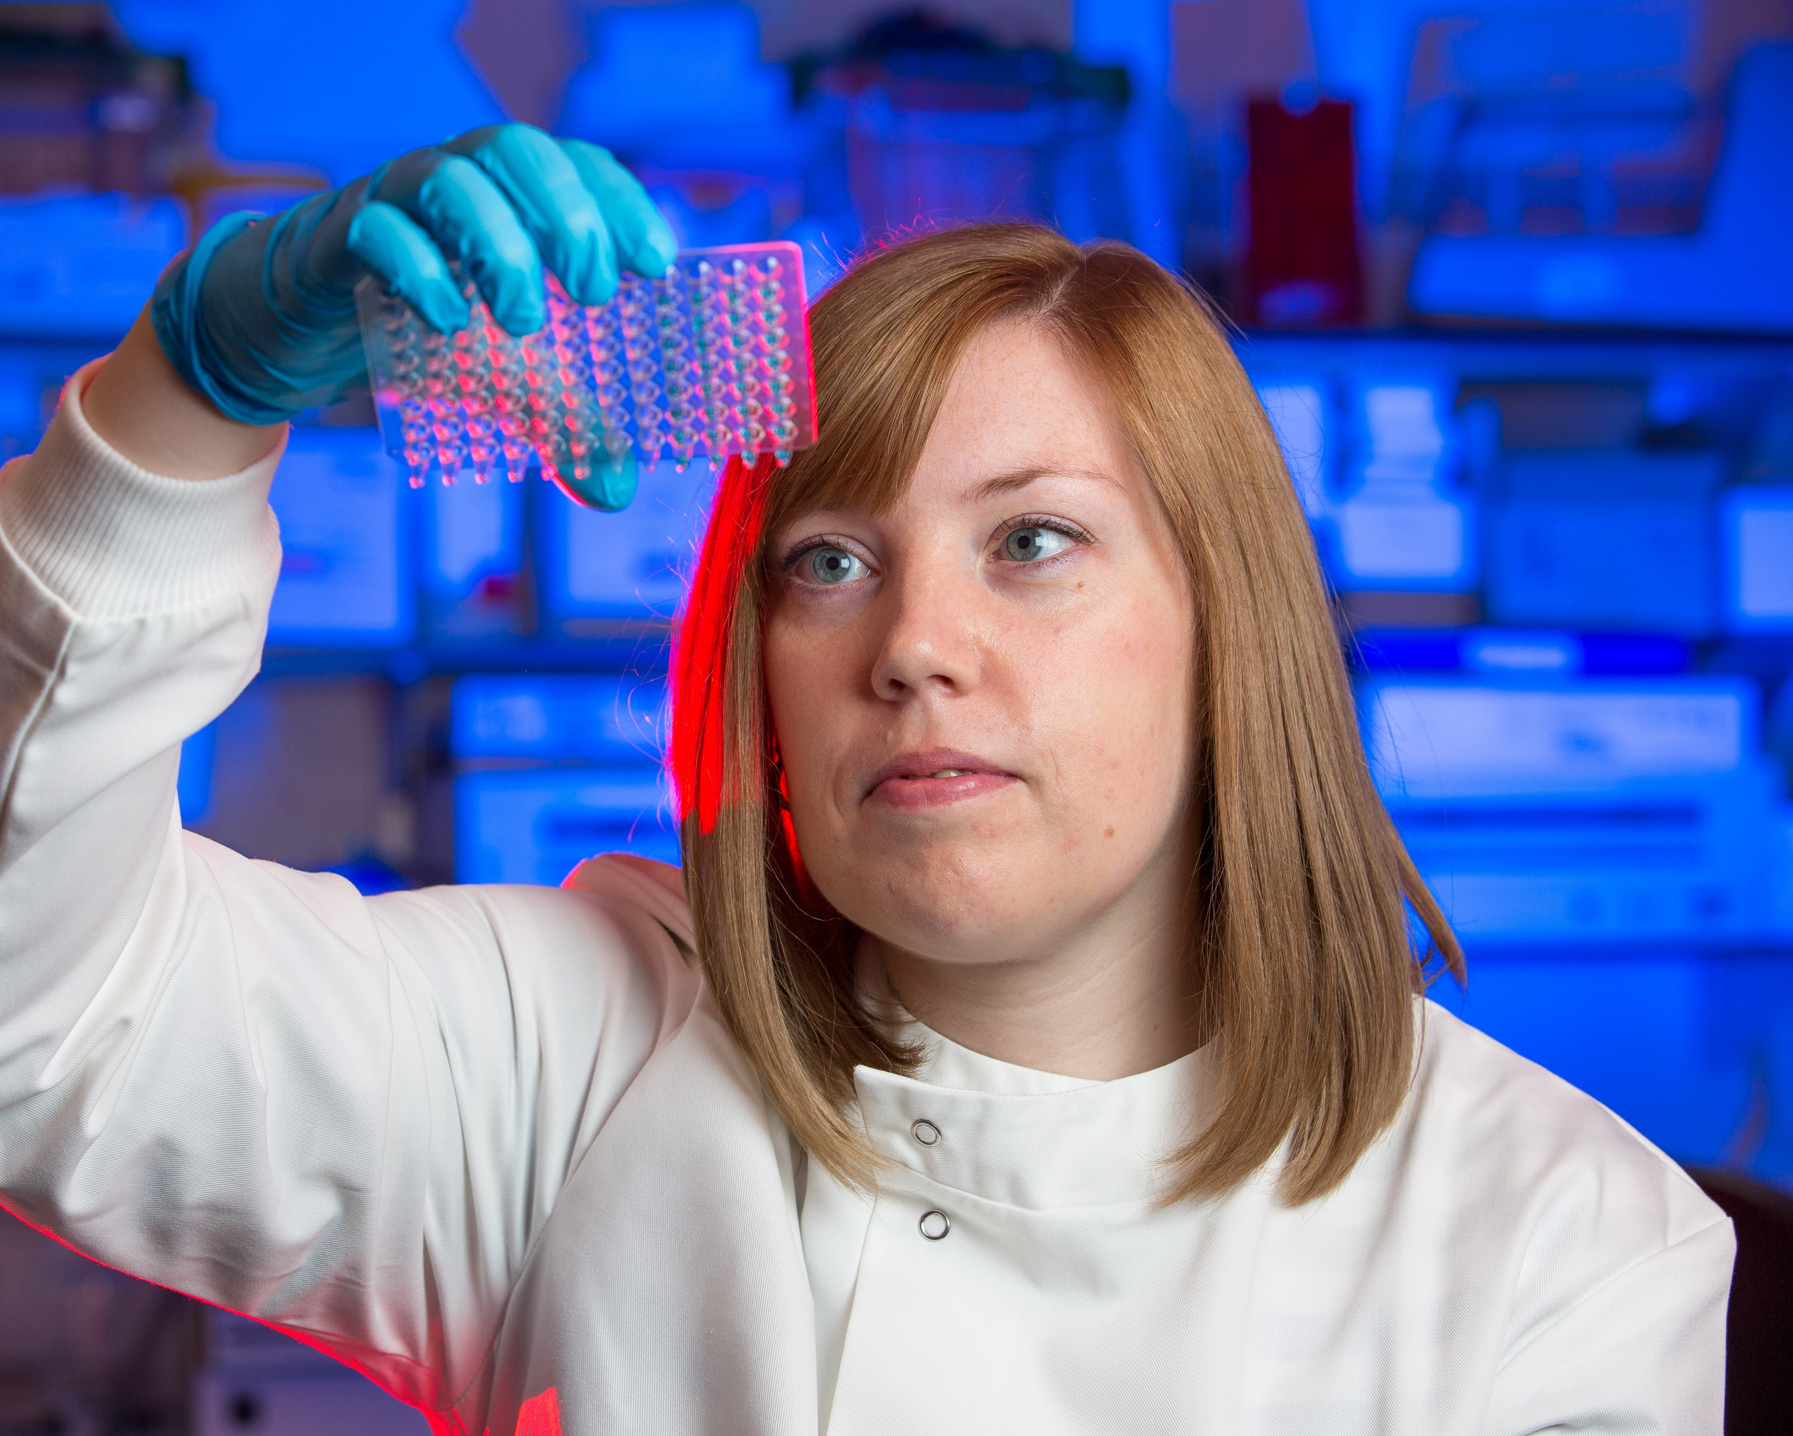
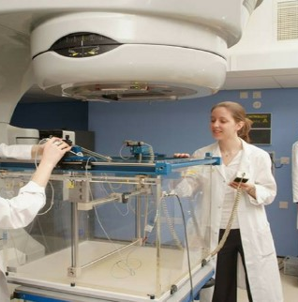
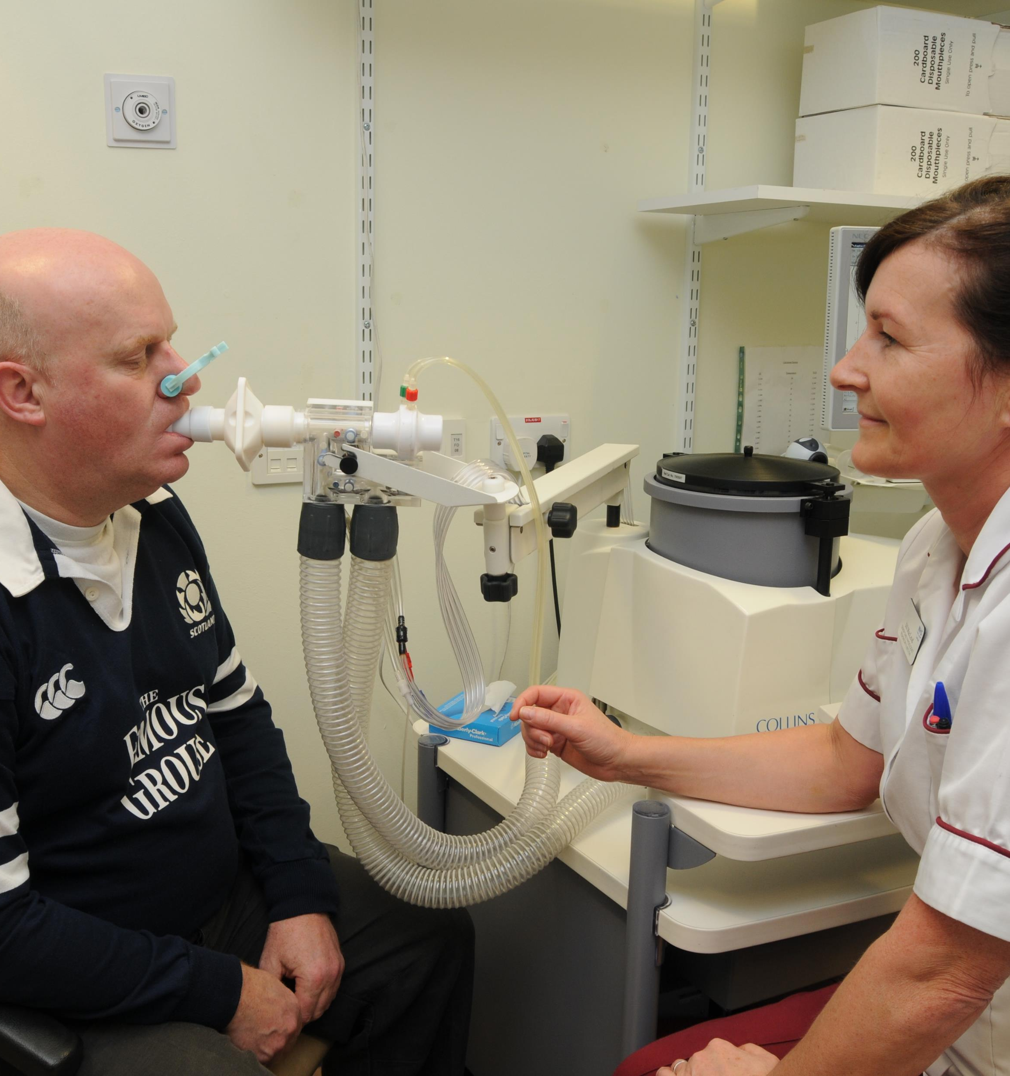
A career in healthcare science
Notes:
You could be a biomedical scientist, analysing a blood sample to help a patient receive an accurate diagnosis. As a bioinformatician, you'd analyse biological data to support the delivery of patient care. Maybe you'd like to work as a clinical photographer, taking digital images to record and monitor a patient's medical condition. You could be a respiratory physiologist using specialist equipment to investigate a patient's breathing problems.

Slide 5
Career Pathway
Consultant Healthcare Scientist
Clinical Scientist
Healthcare Scientist Practitioner
Associate/
Assistant
Healthcare
Scientist
Notes:
Our career pathway is split in to four different parts – provide overview
Assistant / associate practitioners who carry out support roles
HCs Practitioner who carry out the tests / investigations / interventions
Clinical scientists who carry out tests and investigations but also carry out research and development
Consultant HCS – same type of role as a medic but very specialised in their field

Slide 6
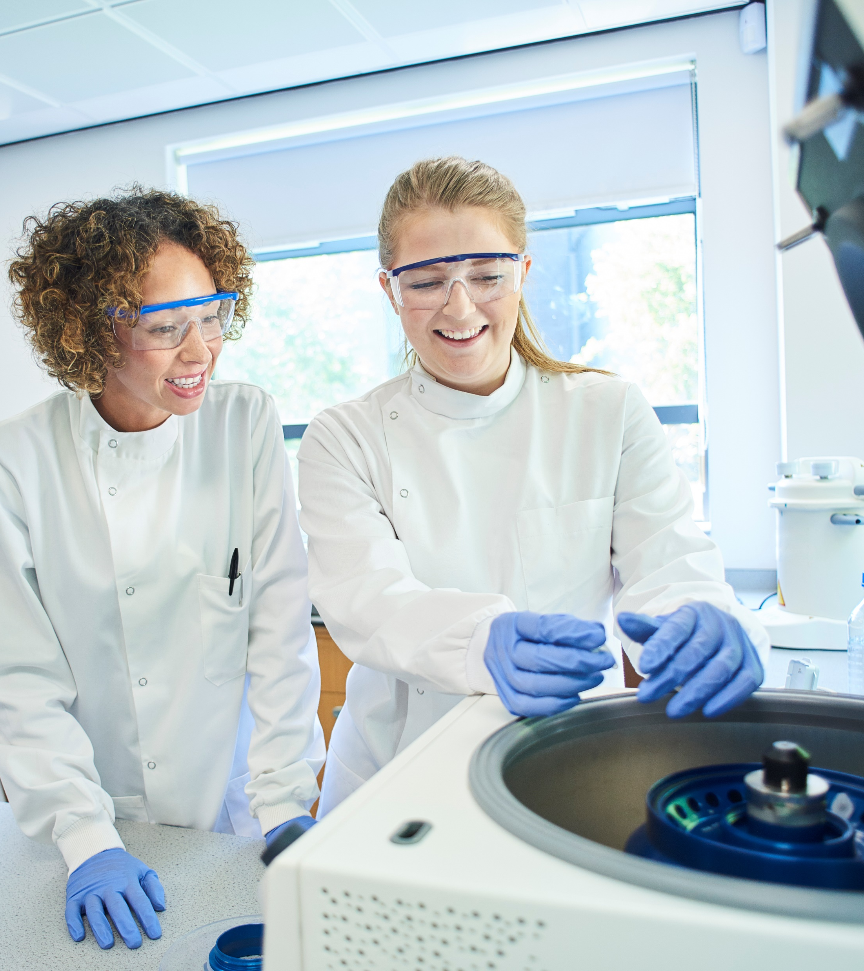
Healthcare science support workers
Our support workers work in a number of specialties across Healthcare science
They undertake a range of support duties that will be dependent on the area in which they work
Entry requirements differ dependent on the specialty.
Notes:
Our support workers work in a number of specialties across Healthcare science In Life Sciences,they work in lots of different areas of the clinical laboratory service, including:
infection sciences
blood sciences
cell sciences
gene sciences
They undertake a range of support duties that will be dependent on the area in which they work
For example, a Biomedical science support workers carry out essential tasks in the laboratory, such as:
prepare biological samples for analysis
update written and electronic records
stock control
assist in the maintenance of laboratory equipment
make sure that the laboratory is a clean and safe working environment
Entry requirements differ dependent on the specialty.
To become a biomedical science support worker, useful school subjects include:
English
Human Biology
Chemistry
Maths

Slide 7
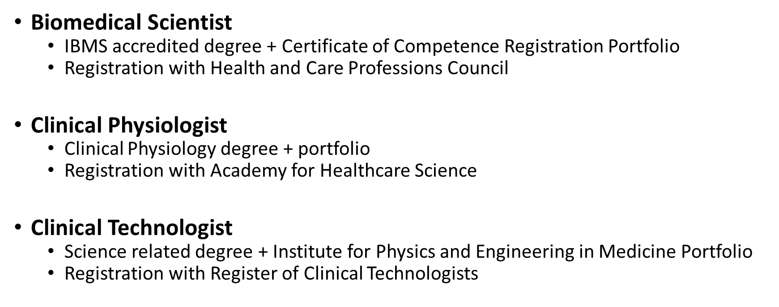
Healthcare science practitioners

Slide 8
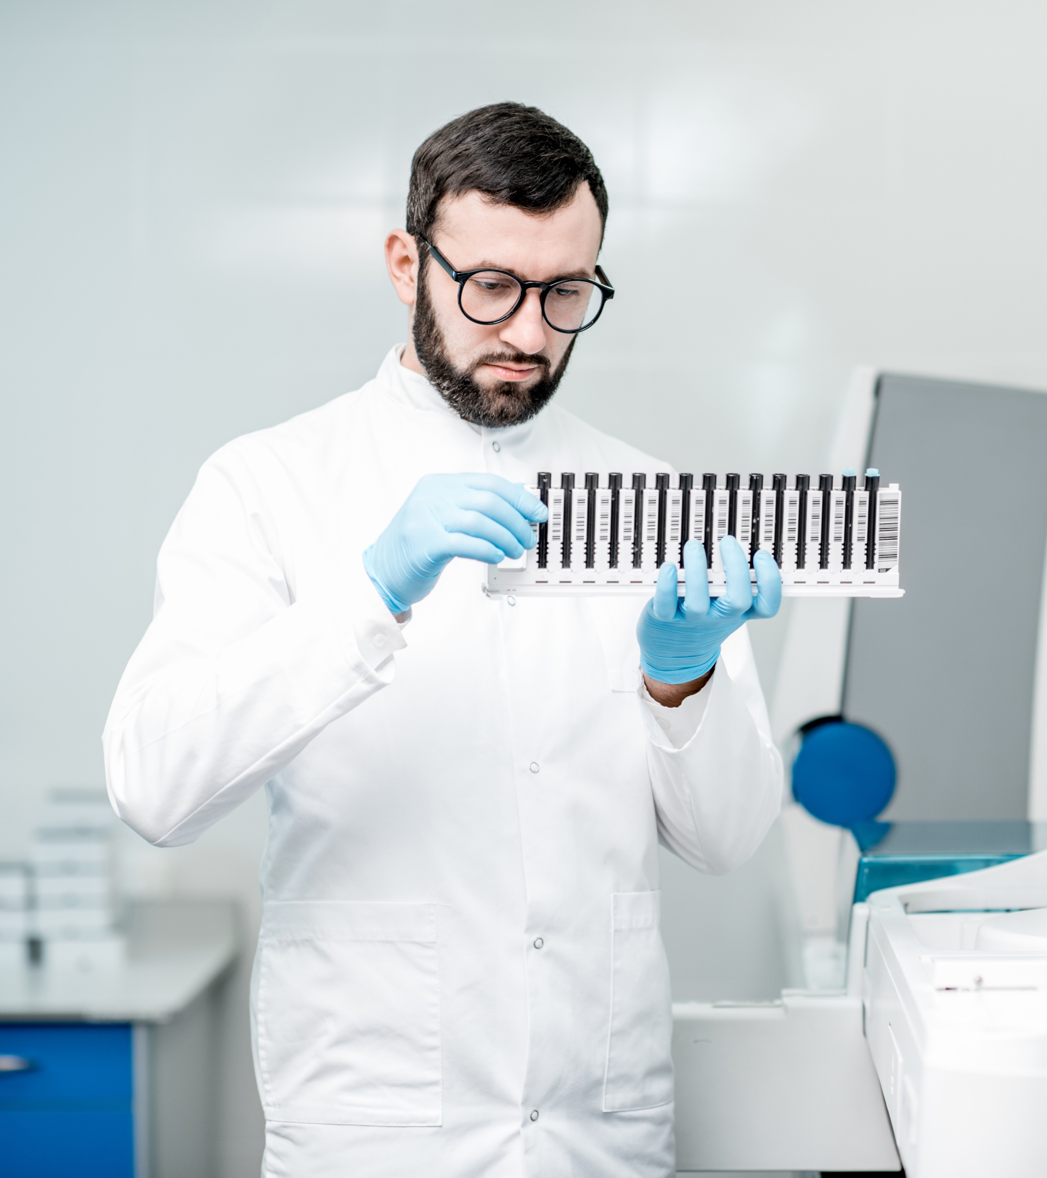
.
What is a biomedical scientist?
Biomedical scientists normally work in laboratories, using computers and complex lab equipment to conduct a wide range of scientific tests..
Generally, biomedical scientists specialise in one of four areas:
infection sciences, including medical microbiology, and virology
blood sciences, such as clinical chemistry, transfusion science, haematology and immunology
cell sciences, for example histopathology and cytology
gene sciences like genetics and molecular pathology
Notes:
What is a biomedical scientist?
Biomedical scientists normally work in laboratories, using computers and complex lab equipment to conduct a wide range of scientific tests. These tests help doctors and other healthcare professionals diagnose, monitor, and manage diseases. Biomedical scientists can also carry out tests for blood transfusion.
Generally, biomedical scientists specialise in one of four areas:
infection sciences, including medical microbiology, and virology
blood sciences, such as clinical chemistry, transfusion science, haematology and immunology
cell sciences, for example histopathology and cytology
gene sciences like genetics and molecular pathology
Operating theatres and accident and emergency wouldn’t be able to function without biomedical scientists. Their work is vital to the detection and investigation of medical conditions

Slide 9
Clinical Scientists
Clinical scientists research and develop techniques and equipment to help prevent, diagnose and treat illness.
Clinical scientists are healthcare and medical experts who support clinical staff in their work with patients.
Their work is very wide ranging and can include laboratory work and testing, basic and applied research, management and teaching
Notes:
There are different education and training pathways to becoming a clinical scientist in various specialisms across Healthcare Science
Clinical scientist training programme
a 3-year work-based learning programme supported by a university-accredited master's degree.
Once you complete the clinical scientist training programme, you’ll register as a clinical scientist with the Health and Care Professions Council (HCPC).
Equivalence
Equivalence is an alternative route you can take to demonstrate that you have the skills, knowledge, and experience to become a clinical scientist.
You’ll submit a portfolio of work to the Academy for Healthcare Science or the Association of Clinical

Slide 10
Clinical Scientists
Scientist Training Programme
Usually supernumerary
3 year pre registration training programme
MSc + Portfolio + Viva HCPC Registration
Continuous assessment with rotations in STP Theme
Equivalence M-level Programme
Usually in service
Length of programme varies
MSc may be required to be undertaken
Candidate must demonstrate equivalence to STP learning outcomes + Viva
HCPC Registration
Notes:
Education and training pathway There are different education and training pathways to becoming a clinical scientist
Clinical scientist training programme
As a trainee, you’ll complete a 3-year programme of work-based learning. During the programme, you’ll gain the skills, knowledge and experience you need to become a clinical scientist in the relevant discipline. To apply to a clinical scientist training programme you must have a relevant scientific undergraduate degree.
·
Once you complete the programme, you’ll register with the Health and Care Professions Council (HCPC) as a clinical scientist.
You can apply for training opportunities on our recruitment website.
Equivalence
Equivalence is an alternative route you can take to demonstrate you have the skills, knowledge, and experience to become a clinical scientist whilst working in the NHS.
You’ll submit a portfolio of work to the Academy for Healthcare Science or the Association of Clinical Scientists for assessment and attend an interview. If successful, you can then register with the HCPC as a clinical scientist.
Find out more about clinical scientist training and equivalence on the NHS Education for Scotland Healthcare Science website.

Slide 11
Your route into NHS Healthcare Science
There are lots of different routes to a rewarding NHS career. Not all roles need a university degree.
Notes:
There are lots of different routes to a rewarding NHS career. Not all roles need a university degree.
You could do an apprenticeship or apply for a training programme. Volunteering and work experience are also good ways to learn about working in the NHS.
Let's learn about some of the routes you can take to a career in the NHS.

Slide 12
Become an apprentice as a Healthcare Science Support Worker
A great way to start a career in the NHS after school
Or for candidates looking to change their career and don’t know where to start
A Modern Apprenticeship will help candidates unlock their potential and learn the knowledge and skills for a successful career.
Notes:
Becoming a Modern Apprentice is a great way to start your career. You'll be employed by an NHSScotland Board while you work towards an industry-recognised qualification with a college or learning provider.
You can apply for a Modern Apprenticeship if you're 16 or older.
What you need to know about becoming a Modern Apprentice in NHSScotland:
entry requirements include National 4, National 5 or Higher qualifications, depending on the role
your qualification will be accredited by the Scottish Qualifications Authority, so you can be sure your training and knowledge are up to date
it could take you up to 4 years to complete your Modern Apprenticeship, depending on the level
You'll be paid at least the Scottish Living Wage. All our vacancies include salary information.

Slide 13
How to apply for NHS jobs in Healthcare Science
Skills, values and knowledge
Notes:
Did you know that there are more than 50 different healthcare science careers?
Healthcare scientists use science, data, product design, and engineering to:
prevent, diagnose, monitor, and treat medical conditions
design and develop custom medical devices
commission and maintain medical equipment
make, improve, and adapt assistive technology
There are many routes to a rewarding healthcare science career, including Modern Apprenticeships, entry-level support roles, and training programmes

Slide 14
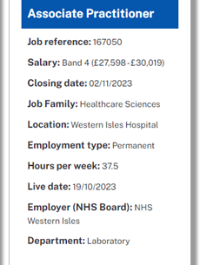
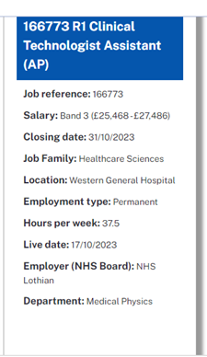
SEARCH FOR JOBS IN THE JOB FAMILY
‘HEALTHCARE SCIENCE

Slide 15
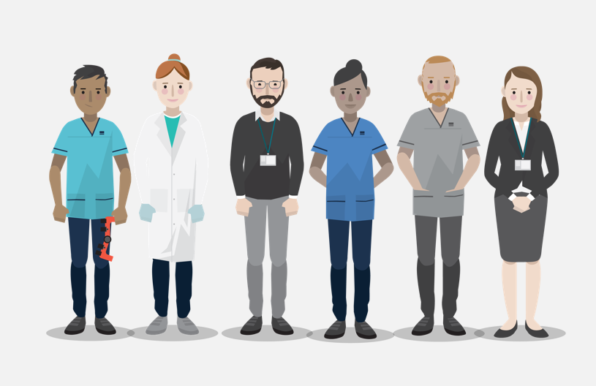
Examples of transferable skills include:
Communication
Ability to multi-task
Health and Safety
attention to detail
problem-solving
time management
teamwork
using technology

Slide 16
Any Questions?

Slide 17
NHS Scotland Careers (Healthcare Science)
https://www.careers.nhs.scot/careers/explore-our-careers/healthcare-science/
NHS Education for Scotland
https://www.nes.scot.nhs.uk/our-work/healthcare-science/
Academy for Healthcare Science
https://www.ahcs.ac.uk/
National School for healthcare Science
http://nshcs.org.uk/
Institute of Biomedical Science (IBMS)
https://www.ibms.org
HCPC registration
https://www.hcpc-uk.org/registration/
STP Programme (England)
https://nshcs.hee.nhs.uk/programmes/stp/
More information
Notes:
We have reference for further information on healthcare science careers included in this presentation and I will forward onto you.
I would now like to hand you over

